Slide 1

Image-Based Food Recognition for Calorie Detection
B.M.S. COLLEGE OF ENGINEERING
(Autonomous college under VTU)
Department of Computer Applications
RESEARCH SEMINAR
22MCA4SRRS
Presented By:
Vaishnavi G.K
1BM23MC109
Guided by:
Dr. Ch Ram Mohan Reddy
Professor

Slide 2
AGENDA
ABSTRACT
INTRODUCTION
LITERATURE SURVEY
RESEARCH GAPS
OBJECTIVES OF INVESTIGATION
DATASET
PROPOSED SYSTEM
VALIDATION
CONCLUSION
FUTURE ENHANCEMENTS
BIBLIOGRAPHY

Slide 3
ABSTRACT
Rising health awareness has increased the need for accurate calorie tracking.
Manual calorie counting is often confusing and time-consuming.
This project introduces an intelligent system that allows users to capture an image of their meal.
The system performs real-time food detection using YOLOv8 and estimates calories.
Calorie values are adjusted contextually using Natural Language Processing (NLP).
Enables better food choices and helps in diet, fitness, and health management.
Ideal for users who want to eat healthy, maintain weight, or monitor intake effortlessly.
Keywords: Calorie Estimation, YOLOv8, NLP, Food Image Analysis, Object Detection, Health Monitoring, Deep Learning, Dietary Management

Slide 4
INTRODUCTION
Increasing health concerns have made calorie awareness a necessity in everyday life.
Manual methods of tracking calorie intake are time-consuming and often inaccurate.
There is a growing demand for intelligent, automated calorie estimation tools.
This project aims to build an AI-based system that detects food items from an image using YOLOv8.
Uses Natural Language Processing (NLP) to understand user descriptions (e.g., “butter dosa from hotel”).
Calculates and adjusts calorie values based on visual and contextual inputs.

Slide 5
LITERATURE SURVEY
“Lightweight Food Image Recognition Algorithm Based on YOLOv8” – Zaoqing Liang, Haoqi Chen, Chenfei Ning, Wenbao Wang, Xiaomin Fang (ISCTech 2024)
Proposed a lightweight, fast food detection model for real-time mobile/edge use.
Used YOLOv8n as base; applied GhostModule (GM) + CBAM attention..
Removed small-object head to reduce overfitting & save computation.
Achieved 91.4% mAP@0.5, reduced GFLOPs to 6.0.
Outperformed YOLOv5, YOLOv7, Fast R-CNN.
Tech: YOLOv8, UEC Food-100 dataset (30 classes).
Limitation: No calorie estimation, no user context
2. “Intelligent Food Identification System Using Improved YOLOv8” – Francia Nitiavintokana, Md Abdur Rouf, Haibin Wu, Aili Wang, Xiaoyu Yu, Yuji Iwahori (ISCSET 2024)
Enhanced YOLOv8 with BiTrains-YOLOv8, and SFPN fusion.
Used semi-supervised training for better generalization.
Dataset: 2650 food images, 41 classes.
Achieved 96.7% accuracy, strong in low-light & clutter.
Outperformed YOLOv5, YOLOv7, R-CNN.
Limitations: No calorie detection, needs powerful hardware.

Slide 6
3. “Food Image Recognition and Calorie Prediction” – Narayana Darapaneni, Vishal Singh, Yasharth Singh Tarkar, Subhav Kataria, Nayana Bansal, Abhijeet Kharade (IEMTRONICS 2021)
Proposed a 4-stage deep learning pipeline for calorie estimation from food images.
Used Mask R-CNN with ResNet-101 for pixel-level segmentation & classification.
Estimated food area via masks; applied “calorie per mask” proportional approximation.
Used transfer learning with COCO weights on 638-image custom dataset (6 classes).
Data sourced from Food101, UNIMIB2016, UEC-FOOD100.
Tech: Mask R-CNN, ResNet-101, area-based calorie model.
Limitation: Area-only estimation (no volume), only 6 classes, needs reference object.
4. “Food Detection and Recognition with Deep Learning: A Comparative Study” – Siao Wah Tan, Chin Poo Lee, Kian Ming Lim, Jit Yan Lim (ICoICT 2023)
Compared deep models for food detection across 3 datasets.
Benchmarked 4 models: SSD (VGG-16), RetinaNet (ResNet-50), YOLOv5, and Faster-RCNN variants.
Datasets: School Lunch, UEC FOOD 100, UEC FOOD 256.
YOLOv5 achieved best speed–accuracy balance; Fast-RCNN (MobileNet-V3) excelled on small-class sets.
Evaluated using mAP; performance varied per dataset.
Limitation: No calorie estimation or segmentation; limited to 3 datasets; some models failed due to hardware constraints.

Slide 7
5. “Deep Learning Framework for Food Item Recognition and Nutrition Assessment” – Prabodh Panindre, Tanmay Mandal, Praneeth Kumar Thummalapalli, Sunil Kumar (ICMCSI 2025)
Proposed YOLOv8m-based nutrition analysis system for mobile use.
Used 95,000-image Roboflow dataset with class merging, balancing, and synonym cleanup.
Estimated food volume using bounding box area + plate size + food thickness + density.
Nutrition (calories, protein, fat, carbs) calculated from estimated volume.
Deployed via Flask on Heroku for real-time mobile inference.
Achieved 79.4% mAP@0.5.
Tech: YOLOv8m, Flask, Heroku, volume-based nutrition.
Limitation: Only 2D image input; fixed nutrient values; struggles with mixed/overlapping foods.
6. “Calorie Estimation of Food and Beverages using Deep Learning” – Dr. Parimala Gandhi A, Ms. Sapna S, Mr. Yaswanth K M, Mr. Praveen Kumar M (ICCMC 2023)
Developed a 6-layer custom CNN for food and beverage calorie estimation from images.
Used edge detection, HSV filtering, and morphological ops for segmentation.
Estimated food volume using real-world object references (e.g., thumb/plate).
Achieved 94.47% accuracy on Fruits-360 + real images.
Outperformed traditional classifiers in controlled setups.
Tech: Custom CNN, Fruits-360 + real mobile-captured dataset.
Limitation: Only 15 fruit classes, no multi-item meals, no NLP, needs reference object in image..

Slide 8
RESEARCH GAPS IDENTIFIED FROM LITERATURE REVIEW
Lack of Comprehensive Nutritional Analysis
No Context-Aware Calorie Adjustment Using NLP
Inadequate Portion Size Estimation
No Handling of Partially visible Food
Lack of Personalization or Feedback Mechanisms

Slide 9
Table 1: Comparative Analysis of Related Work vs. Proposed System
Feature / Capability | Lightweight Food Image Recognition (YOLOv8) | Intelligent Food Identification (YOLOv8 + SFPN) | Food Image Recognition & Calorie Prediction (Mask R-CNN) | Food Detection and Recognition: A Comparative Study | Deep Learning Framework for Nutrition Assessment | Calorie Estimation of Food and Beverages (CNN) | Your Paper (YOLOv8 + NLP + Nutrition Tracking)
Model Type | YOLOv8n + GM + CBAM | YOLOv8 + BiTrains + SFPN | Mask R-CNN (ResNet-101) | YOLOv5, Faster-RCNN, SSD, etc. | YOLOv8m | CNN with edge-based feature extraction | YOLOv8 + NLP + custom JSON
Accuracy | 91.4% mAP@0.5 | 96.7% mAP@0.5 | 90% on 6-class dataset | YOLOv5: 93.5%, Faster-RCNN: 77% | 79.4% on 100-class dataset | 94.47% classification accuracy | 95.1% mAP (YOLOv8) + 93% adjusted calorie accuracy
Calorie Estimation | No | No | Yes (basic area × calorie density) | No | Yes (volume + density based) | Yes (volume via object reference) | Yes (volume + NLP + modifiers)
Nutrition Details | No | No | Only calorie | No | Yes (calories, protein, carbs, fat) | Only calorie | Yes (calories, protein, fat, carbs)
NLP Modifier Support | No | No | No | No | No | No | Yes (butter, hotel, homemade, extra, etc.)
Model Optimization | Yes (low FLOPs, real-time) | Yes (multi-scale, light attention) | No | No | Partial | No | Yes (real-time + NLP pipeline)
Dataset Used | Custom (30-class food dataset) | Custom (2650 images) | 6-class small dataset | UEC FOOD 100/256, School Lunch datasets | 95,000+ food images (custom) | 15 fruits dataset | IndianFood-7 (~3500 images)
Strengths | Lightweight model, good for edge devices | Robust to lighting, semi-supervised learning | Good segmentation, calorie approx. possible | Broad model evaluation | Full nutrition pipeline + deployment | Works with volume and object-based estimation | NLP-aware, full nutrition breakdown, real-world usable
Limitations | No calorie/nutrition estimation | No calorie/nutrition support | Limited food types, segmentation-only | No calorie/nutrition estimation | No segmentation or NLP support | Limited to fruits only | Currently 2D (no depth), relies on area estimation only

Slide 10
OBJECTIVES OF INVESTIGATION
To design a practical solution for estimating food calories using a combination of computer vision and language understanding, addressing the growing need for automated dietary assessment.
To apply object detection techniques, specifically YOLOv8n, for recognizing multiple food items within a single image, especially those commonly found in Indian meals.
To integrate Natural Language Processing (NLP)—using the spaCy library—for interpreting user-provided food descriptions, allowing the system to consider factors like preparation method or source (e.g., "homemade", "extra butter", "from hotel") when estimating calorie content through context-aware modifier adjustments.
To move beyond static calorie databases by developing a system that adapts calorie estimates based on contextual cues, making it more suitable for real-world eating scenarios.
To evaluate the accuracy and performance of the system by comparing predicted calorie values with manually calculated references, and to identify areas for improvement through empirical testing.

Slide 11
DATASET
Roboflow Team, “Indian Food Detection Dataset”
~3500 annotated images across 7 classes
Trained with YOLOv8n for 50 epochs
YOLO format bounding boxes used for labelling
Table 2: Dataset of Image-Based Food Recognition of base Calorie Estimation
Food Item | Calories (kcal) | Protein (g) | Fat (g) | Carbohydrates (g)
Idli | 58 | 1.6 | 0.4 | 12
Poha | 180 | 3.0 | 5.0 | 30
Samosa | 260 | 3.0 | 17.0 | 25
Palak Paneer | 240 | 8.0 | 18.0 | 10
Besan Cheela | 200 | 7.0 | 9.0 | 18
Dosa | 133 | 2.5 | 4.0 | 21
Gulab Jamun | 150 | 2.0 | 5.0 | 28

Slide 12
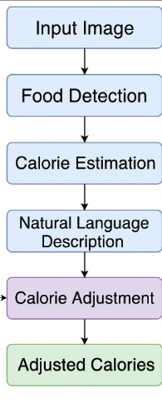
PROPOSED SYSTEM
The proposed system integrates computer vision and natural language processing to automatically estimate food calories from real-world images.
As shown in Figure 1: Overall System Design, the process begins with an image input, which is analyzed using a custom-trained YOLOv8 model to detect and classify food items.
Alongside, the user provides a short textual description (e.g., “butter dosa from hotel”), which is parsed using an NLP module to extract contextual cues like preparation style or food source.
Detected items are matched with a JSON-based calorie reference table, and adjustments are applied based on the parsed context (e.g., “fried” adds calories, “homemade” reduces them).The adjusted calorie values are then presented to the user in real time, enhancing the system’s accuracy and personalization.
Figure 1: Overall System Design of Image-Based Food Recognition for Calorie Detection

Slide 13
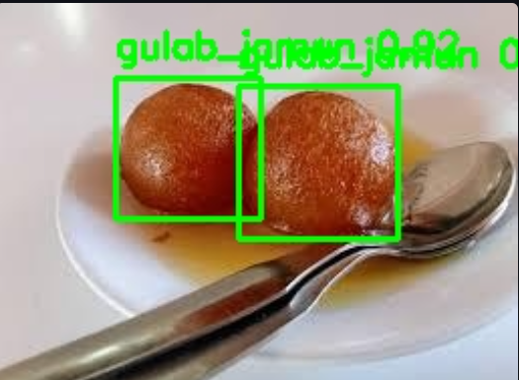
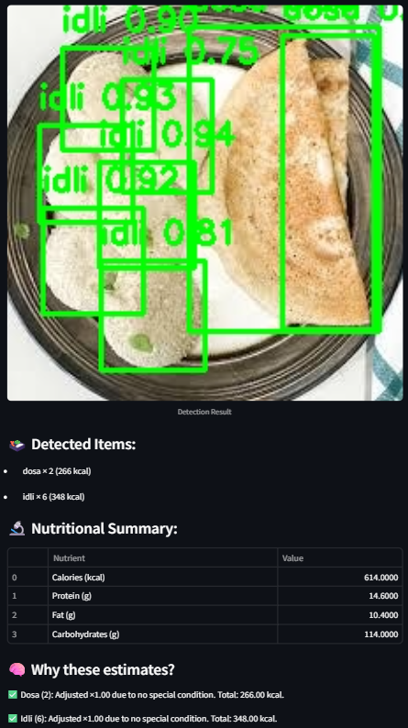
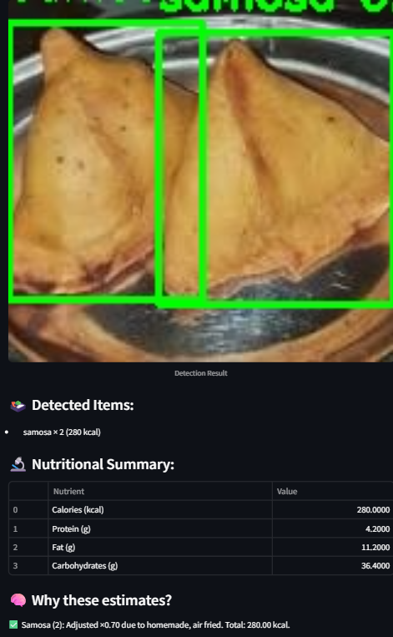
RESULT
The proposed system was tested on diverse food images to evaluate its performance in detecting food items and estimating calories with and without contextual input.
Figure 2 shows the initial detection stage, where the YOLOv8n model accurately identifies multiple food items using bounding boxes.The detection model achieved a mean Average Precision (mAP@0.5) of 95.1%, confirming its reliability in recognizing varied and overlapping foods under real-world conditions.
Figure 3 shows the complete system output, where each detected item is paired with its base calorie value. This demonstrates the core functionality of visual recognition combined with nutritional mapping.
Figure 4 highlights the role of NLP in refining the calorie estimates. For example, when a user enters a phrase like “butter dosa from hotel,” the system interprets these cues and adjusts the calorie values accordingly. The overall adjusted calorie estimation accuracy reached 93%, showing strong alignment with ground truth values even after semantic modifications.
These results validate that the system accurately detects food visually and intelligently modifies calorie estimates through semantic understanding, making it suitable for practical use.
Figure 2. Interface showing detected food items with YOLOv8
bounding boxes
Figure 3: Multi-dish output with calorie values
Figure 4: NLP-enhanced calorie
adjustment

Slide 14
CONCLUSION
The project successfully demonstrates how artificial intelligence can be applied to the domain of nutrition through image-based food detection and context-aware calorie estimation.
By integrating YOLOv8 for visual recognition and NLP for understanding user input, the system provides a more realistic and adaptive calorie prediction model.
The use of a custom Indian food dataset ensures cultural relevance, while the heuristic adjustment rules make the results closer to actual consumption conditions.
Experimental validation confirms the system’s potential for real-world usage in fitness tracking, diet planning, and educational contexts.

Slide 15
FUTURE ENHANCEMENTS
Replace heuristic NLP logic with a fine-tuned language model (e.g., BERT or GPT) for more advanced and flexible interpretation of food descriptions.
Mobile app integration to make the tool more accessible and usable in day-to-day life.
Voice input support for accessibility, especially for visually impaired users or elderly populations.

Slide 16
BIBLIOGRAPHY
B. M. Ahmed et al., A Study on Food Value Estimation From Images,
N. Darapaneni et al., Food Image Recognition and Calorie Prediction,” IEEE IEMTRONICS, 2021.
P. Panindre et al., Deep Learning Framework for Food Item Recognition and Nutrition Assessment, ICMCSI, 2025.
F. Nitiavintokana et al., Intelligent Food Identification System Using Improved YOLOv8, ISCSET, 2024.
Z. Liang et al., Lightweight Food Image Recognition Algorithm Based on YOLOv8, ISCTech, 2024.
P. C. P. et al., CalorieAI: Deep Learning-Based Food Calorie Estimation System, Panimalar Engg. College.
V. Gayatri and M. Thanuja, Indian Food Recognition and Calorie Estimation Using YOLOv8.
USDA FoodData Central, https://fdc.nal.usda.gov
Roboflow Team, “Indian Food Detection Dataset” Roboflow Universe, 2022. [Online]. Available: https://universe.roboflow.com/indianfood/indian_food-pwzlc

